Slide 1

COMO IDENTIFICAR VARIÁVEIS GRAFICAMENTE

Slide 2
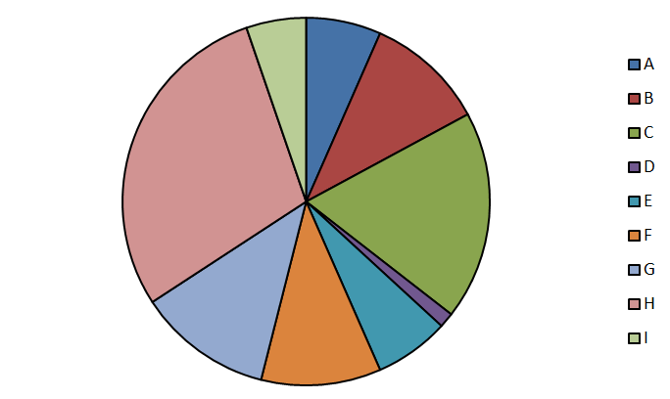

Alerta inicial: Gráficos de pizza
Notes:
Ward et al. (2017)
- in the present research, we focus on a previously unexplored (but common)
situation: when smartphones are not in use, but are merely present;
- Thornton et al. (2014): found that a visually salient cellphone can impair
performance on tasks requiring sustained attention by eliciting awareness of the
"broad social and informational network . . . that one is not part of at the moment";
- IV, salience: (a) high salience, desk condition: nearby and in sight; (b) medium
salience, pocket/bag condition: nearby and out of sight; (c) low salience, other room
condition: in a separate room; turn off the ring and vibrate so that your phone won't
make any sound;
- DVs: WMC (automated Ospan) and functional fluid intelligence (Gf; Raven); both
measures are sensitive to the current availability of attentional resources;
- groups did not differ on phone-related thoughts. Furthermore, a majority of participants indicated that the location of their phones during the experiment did not affect their performance. These results support the idea that the mere presence of one's smartphone may impair cognitive functioning even when it does not occupy the contents of consciousness;

Slide 3
Exemplos
Presença de celular e recursos cognitivos (Ward et al., 2017)
Efeitos de expectativa do experimentador (Rosenthal & Fode, 1963)
Efeito Stroop (Stroop, 1935)
Rótulo verbal em pergunta e memória (Loftus & Palmer, 1974)
Notes:
Ward et al. (2017)
- in the present research, we focus on a previously unexplored (but common)
situation: when smartphones are not in use, but are merely present;
- Thornton et al. (2014): found that a visually salient cellphone can impair
performance on tasks requiring sustained attention by eliciting awareness of the
"broad social and informational network . . . that one is not part of at the moment";
- IV, salience: (a) high salience, desk condition: nearby and in sight; (b) medium
salience, pocket/bag condition: nearby and out of sight; (c) low salience, other room
condition: in a separate room; turn off the ring and vibrate so that your phone won't
make any sound;
- DVs: WMC (automated Ospan) and functional fluid intelligence (Gf; Raven); both
measures are sensitive to the current availability of attentional resources;
- groups did not differ on phone-related thoughts. Furthermore, a majority of participants indicated that the location of their phones during the experiment did not affect their performance. These results support the idea that the mere presence of one's smartphone may impair cognitive functioning even when it does not occupy the contents of consciousness;

Slide 4
Exemplos
Presença de celular e recursos cognitivos (Ward et al., 2017)
Efeitos de expectativa do experimentador (Rosenthal & Fode, 1963)
Efeito Stroop (Stroop, 1935)
Rótulo verbal em pergunta e memória (Loftus & Palmer, 1974)
Notes:
Ward et al. (2017)
- in the present research, we focus on a previously unexplored (but common)
situation: when smartphones are not in use, but are merely present;
- Thornton et al. (2014): found that a visually salient cellphone can impair
performance on tasks requiring sustained attention by eliciting awareness of the
"broad social and informational network . . . that one is not part of at the moment";
- IV, salience: (a) high salience, desk condition: nearby and in sight; (b) medium
salience, pocket/bag condition: nearby and out of sight; (c) low salience, other room
condition: in a separate room; turn off the ring and vibrate so that your phone won't
make any sound;
- DVs: WMC (automated Ospan) and functional fluid intelligence (Gf; Raven); both
measures are sensitive to the current availability of attentional resources;
- groups did not differ on phone-related thoughts. Furthermore, a majority of participants indicated that the location of their phones during the experiment did not affect their performance. These results support the idea that the mere presence of one's smartphone may impair cognitive functioning even when it does not occupy the contents of consciousness;

Slide 5
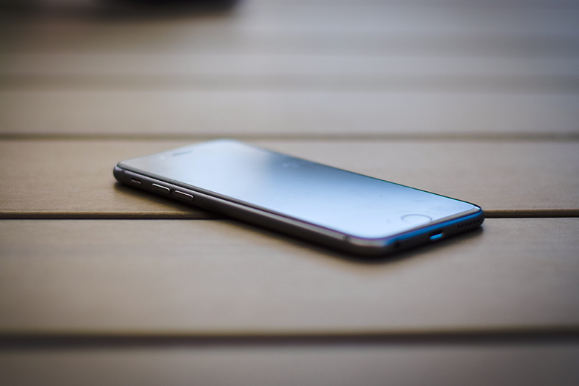
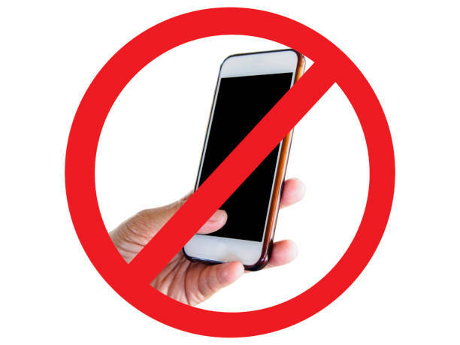
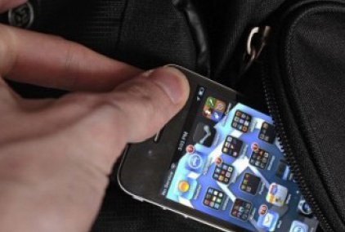
Presença de Celular e Recursos Cognitivos (Ward et al., 2017)
Celulares no silencioso e sem modo vibração
Tarefas de memória de trabalho e de inteligência fluída

Slide 6
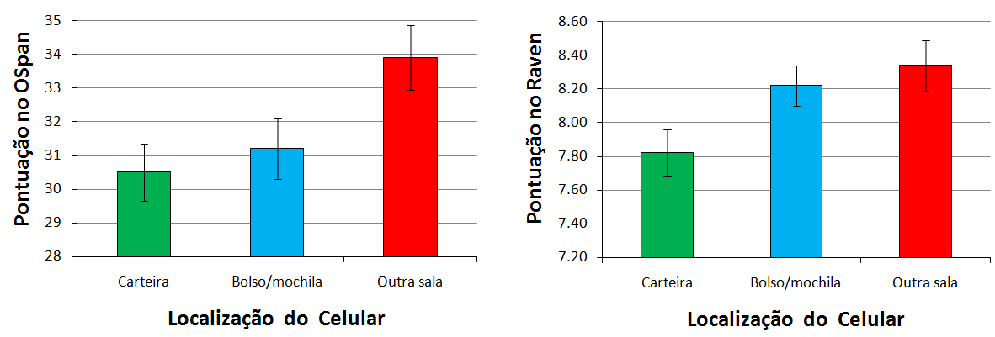
Presença de Celular e Recursos Cognitivos (Ward et al., 2017)
Nota: interpretação das barras de erros depende do que está sendo plotado.

Slide 7
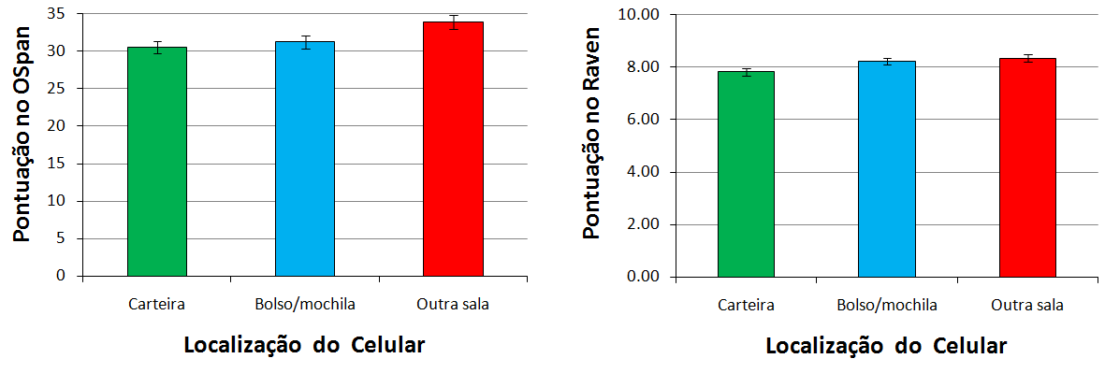
Presença de Celular e Recursos Cognitivos (Ward et al., 2017)
Nota: cheque os limites do eixo y.

Slide 8
Exemplos
Presença de celular e recursos cognitivos (Ward et al., 2017)
Efeitos de expectativa do experimentador (Rosenthal & Fode, 1963)
Efeito Stroop (Stroop, 1935)
Rótulo verbal em pergunta e memória (Loftus & Palmer, 1974)
Notes:
Ward et al. (2017)
- in the present research, we focus on a previously unexplored (but common)
situation: when smartphones are not in use, but are merely present;
- Thornton et al. (2014): found that a visually salient cellphone can impair
performance on tasks requiring sustained attention by eliciting awareness of the
"broad social and informational network . . . that one is not part of at the moment";
- IV, salience: (a) high salience, desk condition: nearby and in sight; (b) medium
salience, pocket/bag condition: nearby and out of sight; (c) low salience, other room
condition: in a separate room; turn off the ring and vibrate so that your phone won't
make any sound;
- DVs: WMC (automated Ospan) and functional fluid intelligence (Gf; Raven); both
measures are sensitive to the current availability of attentional resources;
- groups did not differ on phone-related thoughts. Furthermore, a majority of participants indicated that the location of their phones during the experiment did not affect their performance. These results support the idea that the mere presence of one's smartphone may impair cognitive functioning even when it does not occupy the contents of consciousness;

Slide 9
Exemplos
Presença de celular e recursos cognitivos (Ward et al., 2017)
Efeitos de expectativa do experimentador (Rosenthal & Fode, 1963)
Efeito Stroop (Stroop, 1935)
Rótulo verbal em pergunta e memória (Loftus & Palmer, 1974)
Notes:
Ward et al. (2017)
- in the present research, we focus on a previously unexplored (but common)
situation: when smartphones are not in use, but are merely present;
- Thornton et al. (2014): found that a visually salient cellphone can impair
performance on tasks requiring sustained attention by eliciting awareness of the
"broad social and informational network . . . that one is not part of at the moment";
- IV, salience: (a) high salience, desk condition: nearby and in sight; (b) medium
salience, pocket/bag condition: nearby and out of sight; (c) low salience, other room
condition: in a separate room; turn off the ring and vibrate so that your phone won't
make any sound;
- DVs: WMC (automated Ospan) and functional fluid intelligence (Gf; Raven); both
measures are sensitive to the current availability of attentional resources;
- groups did not differ on phone-related thoughts. Furthermore, a majority of participants indicated that the location of their phones during the experiment did not affect their performance. These results support the idea that the mere presence of one's smartphone may impair cognitive functioning even when it does not occupy the contents of consciousness;

Slide 10

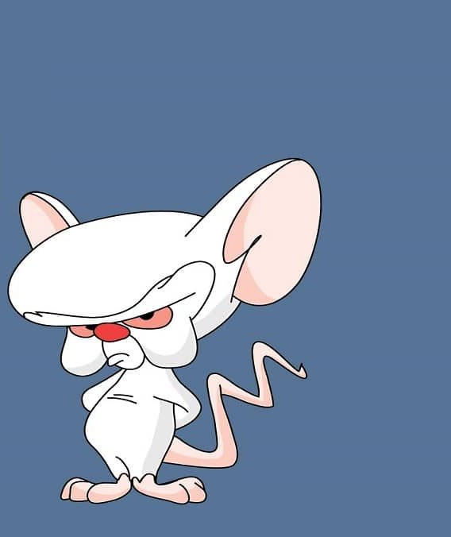
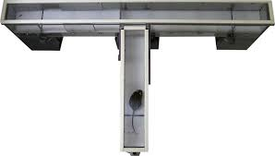
Efeitos de Expectativa do Experimentador (Rosenthal & Fode, 1963)
Doze estudantes treinaram 5 ratos cada
3 fêmeas e 2 machos por grupo
Grupos balanceados em termos de idade
Aprendizagem de discriminação
Ratos burros
Ratos brilhantes
Desempenho
Número de escolhas corretas por dia
Número de tentativas sem resposta
Tempo médio (min) necessário para fazer uma escolha correta

Slide 11
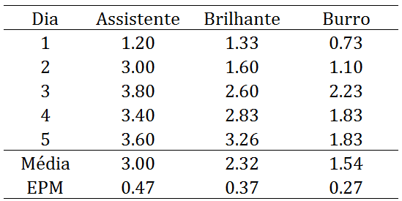
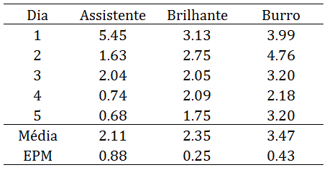
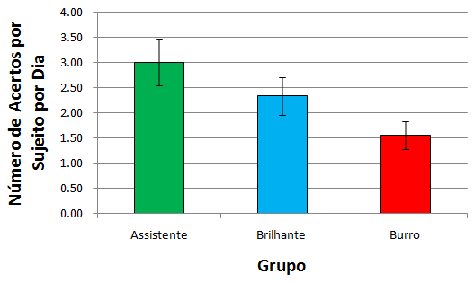
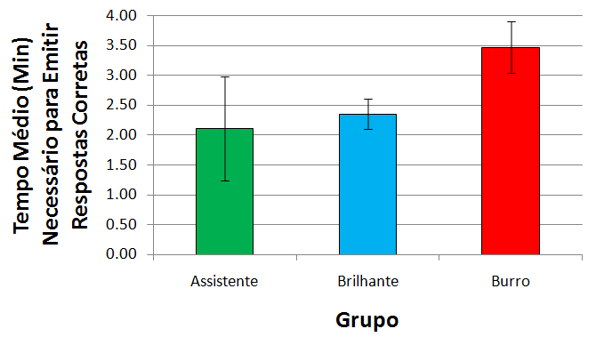
Efeitos de Expectativa do Experimentador (Rosenthal & Fode, 1963)

Slide 12
Exemplos
Presença de celular e recursos cognitivos (Ward et al., 2017)
Efeitos de expectativa do experimentador (Rosenthal & Fode, 1963)
Efeito Stroop (Stroop, 1935)
Rótulo verbal em pergunta e memória (Loftus & Palmer, 1974)
Notes:
Ward et al. (2017)
- in the present research, we focus on a previously unexplored (but common)
situation: when smartphones are not in use, but are merely present;
- Thornton et al. (2014): found that a visually salient cellphone can impair
performance on tasks requiring sustained attention by eliciting awareness of the
"broad social and informational network . . . that one is not part of at the moment";
- IV, salience: (a) high salience, desk condition: nearby and in sight; (b) medium
salience, pocket/bag condition: nearby and out of sight; (c) low salience, other room
condition: in a separate room; turn off the ring and vibrate so that your phone won't
make any sound;
- DVs: WMC (automated Ospan) and functional fluid intelligence (Gf; Raven); both
measures are sensitive to the current availability of attentional resources;
- groups did not differ on phone-related thoughts. Furthermore, a majority of participants indicated that the location of their phones during the experiment did not affect their performance. These results support the idea that the mere presence of one's smartphone may impair cognitive functioning even when it does not occupy the contents of consciousness;

Slide 13
Exemplos
Presença de celular e recursos cognitivos (Ward et al., 2017)
Efeitos de expectativa do experimentador (Rosenthal & Fode, 1963)
Efeito Stroop (Stroop, 1935)
Rótulo verbal em pergunta e memória (Loftus & Palmer, 1974)
Notes:
Ward et al. (2017)
- in the present research, we focus on a previously unexplored (but common)
situation: when smartphones are not in use, but are merely present;
- Thornton et al. (2014): found that a visually salient cellphone can impair
performance on tasks requiring sustained attention by eliciting awareness of the
"broad social and informational network . . . that one is not part of at the moment";
- IV, salience: (a) high salience, desk condition: nearby and in sight; (b) medium
salience, pocket/bag condition: nearby and out of sight; (c) low salience, other room
condition: in a separate room; turn off the ring and vibrate so that your phone won't
make any sound;
- DVs: WMC (automated Ospan) and functional fluid intelligence (Gf; Raven); both
measures are sensitive to the current availability of attentional resources;
- groups did not differ on phone-related thoughts. Furthermore, a majority of participants indicated that the location of their phones during the experiment did not affect their performance. These results support the idea that the mere presence of one's smartphone may impair cognitive functioning even when it does not occupy the contents of consciousness;

Slide 14
Efeito Stroop (Stroop, 1935)
Experimento 1:
leitura de palavras
BLUE GREEN RED
RED PURPLE…
BLUE GREEN RED
RED PURPLE…
Experimento 2:
nomeação de cores
BLUE GREEN RED
RED PURPLE…
…

Slide 15
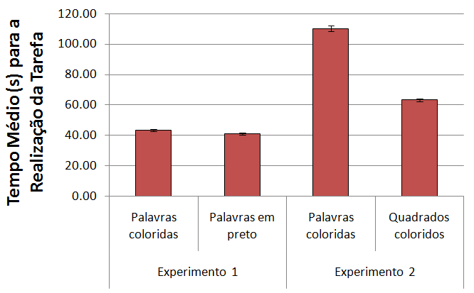
Efeito Stroop (Stroop, 1935)

Slide 16
Exemplos
Presença de celular e recursos cognitivos (Ward et al., 2017)
Efeitos de expectativa do experimentador (Rosenthal & Fode, 1963)
Efeito Stroop (Stroop, 1935)
Rótulo verbal em pergunta e memória (Loftus & Palmer, 1974)
Notes:
Ward et al. (2017)
- in the present research, we focus on a previously unexplored (but common)
situation: when smartphones are not in use, but are merely present;
- Thornton et al. (2014): found that a visually salient cellphone can impair
performance on tasks requiring sustained attention by eliciting awareness of the
"broad social and informational network . . . that one is not part of at the moment";
- IV, salience: (a) high salience, desk condition: nearby and in sight; (b) medium
salience, pocket/bag condition: nearby and out of sight; (c) low salience, other room
condition: in a separate room; turn off the ring and vibrate so that your phone won't
make any sound;
- DVs: WMC (automated Ospan) and functional fluid intelligence (Gf; Raven); both
measures are sensitive to the current availability of attentional resources;
- groups did not differ on phone-related thoughts. Furthermore, a majority of participants indicated that the location of their phones during the experiment did not affect their performance. These results support the idea that the mere presence of one's smartphone may impair cognitive functioning even when it does not occupy the contents of consciousness;

Slide 17
Exemplos
Presença de celular e recursos cognitivos (Ward et al., 2017)
Efeitos de expectativa do experimentador (Rosenthal & Fode, 1963)
Efeito Stroop (Stroop, 1935)
Rótulo verbal em pergunta e memória (Loftus & Palmer, 1974)
Notes:
Ward et al. (2017)
- in the present research, we focus on a previously unexplored (but common)
situation: when smartphones are not in use, but are merely present;
- Thornton et al. (2014): found that a visually salient cellphone can impair
performance on tasks requiring sustained attention by eliciting awareness of the
"broad social and informational network . . . that one is not part of at the moment";
- IV, salience: (a) high salience, desk condition: nearby and in sight; (b) medium
salience, pocket/bag condition: nearby and out of sight; (c) low salience, other room
condition: in a separate room; turn off the ring and vibrate so that your phone won't
make any sound;
- DVs: WMC (automated Ospan) and functional fluid intelligence (Gf; Raven); both
measures are sensitive to the current availability of attentional resources;
- groups did not differ on phone-related thoughts. Furthermore, a majority of participants indicated that the location of their phones during the experiment did not affect their performance. These results support the idea that the mere presence of one's smartphone may impair cognitive functioning even when it does not occupy the contents of consciousness;

Slide 18
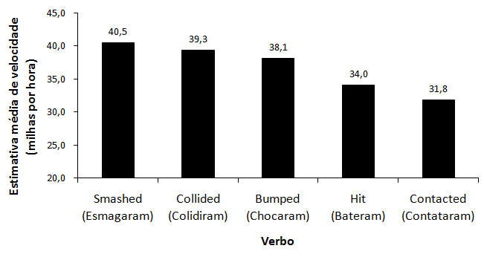
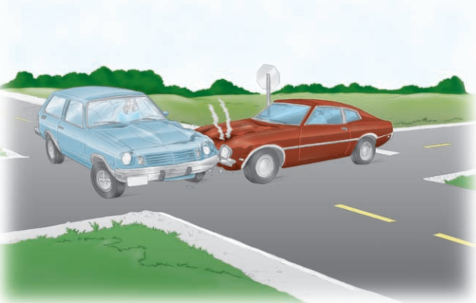
Rótulo verbal em pergunta e memória (Loftus & Palmer, 1974)
VI—verbo usado na pergunta sobre acidente: esmagaram, colidiram, chocaram, bateram, contataram
VD—Velocidade estimada

Slide 19
Próximos vídeos…
Experimentos com mais de uma VI
O que é efeito de interação
Tipos de interação

Slide 20
ATÉ O PRÓXIMO VÍDEO! ☺

Slide 21
Referências
Cozby, P. C., & Bates, S. C. (2018). Methods in behavioral research (13th ed.). McGraw-Hill.
Loftus, E. F., & Palmer, J. C. (1974). Reconstruction of automobile destruction: An example of the interaction between language and memory. Journal of Verbal Learning and Verbal Behavior, 13, 585–589. https://doi.org/10.1016/S0022-5371(74)80011-3
MacLeod, C. M. (1991). Half a century of research on the Stroop effect: An integrative review. Psychological Bulletin, 109(2), 163–203. https://doi.org/10.1037/0033-2909.109.2.163
Rosenthal, R., & Fode, K. L. (1963). The effect of experimenter bias on the performance of the albino rat. Behavioral Science, 8, 183-189. https://doi.org/10.1002/bs.3830080302
Stroop, J. R. (1935b). Studies of interference in serial verbal reactions. Journal of Experimental Psychology, 18, 643–662. https://doi.org/10.1037/h0054651
Ward, A. F., Duke, K., Gneezy, A., & Bos, M. W. (2018). Brain drain: The mere presence of one’s own smartphone reduces available cognitive capacity. Journal of the Association for Consumer Research, 2(2), 140–154. https://doi.org/10.1086/691462

